Slide 1
Topic 7
Tree (Part I)
資料結構與程式設計
Data Structure and Programming
11/14/2018

Slide 2
What we have learned before...
We have learned some linear type data structures --- list, array, queue, stack, etc.
However, in real life, many data types are NOT stored in a linear sequence. For example,
  Directories and files
  Employee structure in a company

Slide 3
In additon, complexity tradeoffs ---
Remember in “List and Array” topic we compare the complexity of the following functions
 | DList | Array
Insert (any pos) | O(1) | O(n) or O(1)
Erase (any pos) | O(1) | O(n) or O(1)
Find | O(n) | O(n log n) to sort the array, O(log n) to find
Memory Overhead | 16*n + 16 | 24

Slide 4
Remember the difference between
→ O(1), O(log n ), O(n)
To have better “find” performance
➔ Data needs to be sorted
List ➔ fast in insert/erase, slow in find
  Data cannot be sorted efficiently
Array ➔ not good in insert/erase, OK in find
  Takes O(n log n) to update the order
What if we need to
  Many “find()” operations
  Some “insert/erase” operation from time to time

Slide 5
In other words...
Find
Find
Sorted
Data Structure
Sorted
Data Structure
Insert / Erase

Slide 6
Better DS for “find”
We will introduce several data types that have good “find” complexity (O(log n)), and OK “insert/erase” complexity (also O(log n))
  Heap
  Set
  Map
➔ They are all different variations of “Tree” data structure

Slide 7

Tree
In a logic view, it’s actually an upside-down tree
Usually used in representing hierarchy or relationship
  e.g. File directories
Root
→ branches
→ leaves
  No re-convergence
a
b
c
d
e
f
g
h
i
j
k
l

Slide 8

Unix or DOS/Windows file system
Prof. Yen, “Data Structure” class

Slide 9
TERMINOLOGY
Property: (#edges) = (#nodes) - 1
Prof. Yen, “Data Structure” class

Slide 10

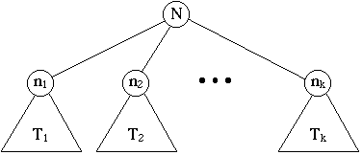
Definition of a Tree
This definition is “recursive” and “constructive”.
  A single node is a tree. It is "root."
  Suppose N is a node and T₁, T₂, ..., T_{k} are trees with roots n₁, n₂, ...,n_{k}, respectively. We can construct a new tree T by making N the parent of the nodes n₁, n₂, ..., n_{k}. Then, N is the root of T, and T₁, T₂, ..., T_{k} are subtrees.
Prof. Yen, “Data Structure” class

Slide 11
Trees Implementation (1)
struct TreeNode
{
MyClass _data;
TreeNode* _child1;
TreeNode* _child2;
.
.
TreeNode* _childm;
};
_data
Straightforward implementation
Mem usage: d * n + 8 * (n * m)
Problem
➔ Not flexible in number of children
➔ Good for fixed number of children (e.g. Binary Tree)

Slide 12
Trees Implementation (2)
struct TreeNode
{
MyClass _data;
TreeNode* _child1; // head to a list
TreeNode* _sibling; // head to a list
};
Flexible in number of children
Save memory?
  Mem usage: d * n + 8 * 2n
Problem
  Not straightforward in interpretation
  Not friendly in child and sibling traversal

Slide 13
Data Structure View
a
b
c
d
e
f
g
h
i
j
a
_sibling
_child1
k
l
b
c
d
e
h
i
j
f
g
k
l
Prof. Yen, “Data Structure” class

Slide 14
Trees Implementation (3)
class TreeNode
{
MyClass _data;
Array<TreeNode *> _children;
};
Straightforward view
Flexible in number of children
Mem usage: d * n + 8 * (3n – 1) (why?)
Problem
  Not easy to access siblings
  (but is that really a problem?)

Slide 15
Trees Implementation (4)
template <class T>
class TreeNode
{
T _data;
Array<TreeNode<T> *> _children;
};
template <class T>
class Tree
{
TreeNode<T>* _root;
};

Slide 16
Traversal of Trees
Preorder: Process the node, then recursively process the left and right subtrees.
Inorder: Process the left subtree, the node, and the right subtree. ⬅ for binary tree
Postorder: Process the left subtree, the right subtree, and the node.
Levelorder: top-to-bottom, left-to-right order
Prof. Yen, “Data Structure” class

Slide 17
Tree Traversal: InOrder
In Order is easily described recursively:
  Visit left subtree (if there is one) In Order
  Visit root
  Visit right subtree (if there is one) In Order
algorithm inOrder(TreeNode t)
  Input: a tree node (can be considered to be a tree)
  Output: None.
  if t has a left child
  inOrder(left child of t)
  Visit node t
  if t has a right child
  inOrder(right child of t)

Slide 18
Tree Traversal: PreOrder
Another common traversal is PreOrder.
It goes as deep as possible (visiting as it goes)
  Visit root
  Visit left subtree in PreOrder
  Visit right subtree in PreOrder
algorithm preOrder(TreeNode t)
  Input: a tree node (can be considered to be a tree)
  Output: None.
  Visit node t // Numbering, action, etc
  if t has a left child
  preOrder(left child of t)
  if t has a right child
  preOrder(right child of t)

Slide 19
Tree Traversal: PostOrder
PostOrder traversal also goes as deep as possible, but only visits
internal nodes during backtracking.
  Visit left subtree in PostOrder
  Visit right subtree in PostOrder
  Visit root
algorithm postOrder(TreeNode t)
  Input: a tree node (can be considered to be a tree)
  Output: None.
  if t has a left child
  postOrder(left child of t)
  if t has a right child
  postOrder(right child of t)
  Visit node t

Slide 20
LevelOrder Traversal
How to prove the correctness of this algorithm?
algorithm levelOrder(TreeNode t)
  Input: a tree node (can be considered to be a tree)
  Output: None.
  Let Q be a Queue
  Q.enqueue(t)
  while the Q is not empty
  n = Q.dequeue()
  Visit node n
  if n has a left child
  Q.enqueue(left child of n)
  if tree has a right child
  Q.enqueue(right child of n)

Slide 21
Example:
Level-Order Queue
Process | Enqueue | Q
 | a | a
a | b,c,d,e | bcde
b | f,g | cdefg
c |  | defg
d | h,i,j | efghij
e |  | fghij
f |  | ghij
g | k | hijk
h |  | ijk
i | l | jkl
j |  | kl
k |  | l
l
a
b
c
d
e
h
i
j
f
g
k
l
Prof. Yen, “Data Structure” class
Notes:
Walk through the pictured example in stages:
Start with an empty Q
At stage 0, enqueue a, leaving Q={a}
At stage 1, dequeue and process a, enqueue a’s children bcde, leaving Q={bcde}
At stage 2, dequeue and process b, enqueue b’s children fg, leaving Q={cdefg}
etc.

Slide 22
Not just learn. Use smartly...
Which kind of tree traversal to use?
  Pre-order
  Post-order
  In-order
  Level-order

Slide 23
Quiz!!
Given a tree and we like to perform tree traversal, numbering from 1 to n...
If the number in a node should be smaller than its children (i.e. patent first)...
  ➔ Pre-order traversal
If the number in a node should be greater than its children (i.e. children first)...
  ➔ Post-order traversal

Slide 24
Do we need the “_sibling” field?
For tree traversal, NO.
All we need to know is “_children”.
How about other functions?
  Insert?
  Erase?
  Where?????
➔ How do these functions operate in a Tree?
What if TreeNodes need to be sorted?
➔ We will discuss general sorted tree later.
We will look at one special kind of sorted tree
--- Binary Tree first

Slide 25
Binary Trees
Prof. Yen, “Data Structure” class

Slide 26
Properties of Binary Trees

Slide 27
Special Binary Trees
Full / Complete binary tree
Binary Search Tree (BST)
(Balanced) Binary Search Tree

Slide 28
Full Binary Tree
A full binary tree of height h is a binary tree of height h having exactly 2^{(h+1)} – 1 nodes
  All external nodes have same depth = h
  All internal nodes have non-empty left and right children
1
2
3
height = 2
#nodes = 7
4
5
6
7

Slide 29
Complete Binary Tree
A complete binary tree is a special case of a binary tree, in which all the levels, except perhaps the last, are full; while on the last level, any missing nodes are to the right of all the nodes that are present.
1
1
1
2
3
2
3
2
3
4
5
6
4
5
4
5
7
yes
yes
no

Slide 30
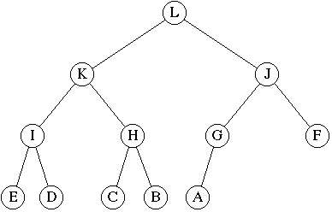
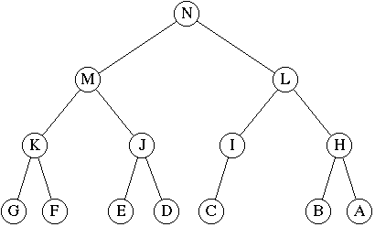
Complete/Full Binary Tree Example
Is this a full binary tree?
  No – not all leaf nodes are at the same level.
  No - node G has an empty right and a non-empty left.
Is it a complete binary tree?
  Yes
Is this a full binary tree?
  No - node I has an empty right and a non-empty left.
Is it a complete binary tree?
  No – the final level is not completed in left-to-right fashion
Prof. Yen, “Data Structure” class

Slide 31
Binary Tree Implementation (1)
Since the number of children of a binary tree is fixed, we can implement it as
  template <class T>
  class BinaryTreeNode
  {
  T _data;
  BinaryTreeNode<T>* _left;
  BinaryTreeNode<T>* _right;
  };
  template <class T>
  class BinaryTree
  {
  BinaryTreeNode<T>* _root;
  };
  ➔ Memory usage: d*n + 8 * 2n

Slide 32
Memory Usage Consideration
An observation ---
  In 64-bit or higher platform, the memory usage of pointer variables is bigger than that of (unsigned) integers. So we can use “indices” for the child nodes, instead of pointers. That is,
  class BinaryTreeNode {
  T _data;
  unsigned _left;
  unsigned _right;
  };
  What do you think?
  What extra data structure do you need?
  What is the total memory usage?
  What if some node is deleted?
BinaryTree
_root

Slide 33
Binary Tree Implementation (2)
If a binary tree is complete
➔ Use array for implementation
Let the height of the tree = ‘h’
  #nodes must >= 2^{h} and <= 2^{(h+1)} – 1
  root has index = 1
  A node with index t
    index of left child = 2t
    index of right child = 2t + 1
    Index of parent = t / 2
1
2
3
4
5
6
7

Slide 34
Binary Search Trees (BST)
A binary search tree is a binary tree T such that
  each internal node stores an item (k, e) of a dictionary.
  keys stored at nodes in the left subtree of v are less than or equal to k.
  keys stored at nodes in the right subtree of v are greater than or equal to k.
  external nodes do not hold elements but serve as place holders.
Prof. Yen, “Data Structure” class

Slide 35
Search in BST
A binary search tree T is a decision tree, where the question asked at an internal node v is whether the search key k is less than, equal to, or greater than the key stored at v.
if v is an external node then
return v // mean the key should be inserted here
if k = key(v) then
return v // find a match
else if k < key(v) then
return TreeSearch(k, T.leftChild(v))
else { k > key(v) }
return TreeSearch(k, T.rightChild(v))
Prof. Yen, “Data Structure” class

Slide 36
Search Example I
What is the running time ?
Successful findElement(76)
76>44
76<88
76>65
76<82
A successful search traverses a path starting at the root and ending at an internal node
Prof. Yen, “Data Structure” class

Slide 37
Search Example II
What is the running time ?
Unsuccessful findElement(25)
25<44
25>17
25<32
25<28
leaf node
An unsuccessful search traverses a path starting at the root and ending at an external node
Prof. Yen, “Data Structure” class

Slide 38
Insert a Key
TreeNode insert(int x, TreeNode T)
{ if ( T == NULL )
return new TreeNode(x,null,null);
if (x == T.Element)
return T;
if (x < T.Element)
T.Left = insert(x, T.Left);
else T.Right = insert(x, T.Right);
return T;
}
3
10
5
15
2
9
20
3
7
What is the running time ?
17
30
Prof. Yen, “Data Structure” class
Notes:
The running time is again O(height(T)). Even more important to keep height(T) small

Slide 39
Delete a Key
10
How do you delete:
17 ?
9 ?
20 ?????
5
15
2
9
20
7
17
30
Let’s look at two basic operations:
min() and successor() first!!
Notes:
And now for something completely different.
Let’s say I want to delete a node. Why might it be harder than insertion?
Might happen in the middle of the tree instead of at leaf.
Then, I have to fix the BST.

Slide 40
FindMin
10
5
15
2
9
20
TreeNode min(Node T) {
if (T.Left == NULL)
return T;
else
return min(T.Left); }
7
17
30
How many children can the min of a node have?
Prof. Yen, “Data Structure” class
Notes:
Every now and then everyone succumbs to the temptation to really overuse color.

Slide 41
Successor
Find the next larger node in this node’s subtree.
  Find “min” of the right child
  (What if no right child?)
  [Compare] second largest
10
5
15
TreeNode succ(TreeNode T) {
if (T.right == NULL)
return NULL;
else
return min(T.right);
}
2
9
20
7
17
30
How many children can the successor of a node have?
Prof. Yen, “Data Structure” class
Notes:
Here’s a little digression.
Maybe it’ll even have an application at some point.
Find the next larger node in 10’s subtree.
Can we define it in terms of min and max?
It’s the min of the right subtree!

Slide 42
Deletion (1) - Leaf Case
Delete(17)
10
5
15
2
9
20
7
17
30
Trivial !!
Prof. Yen, “Data Structure” class
Notes:
Alright, we did it the easy way, but what about real deletions?
Leaves are easy; we just prune them.

Slide 43
Deletion (2) - One Child Case
Delete(15)
10
5
15
2
9
20
7
30
Trivial !!
Prof. Yen, “Data Structure” class
Notes:
Single child nodes we remove and…
Do what?
We can just pull up their children.
Is the search tree property intact?
Yes.

Slide 44
Deletion (3) - Two Children Case
Delete(5)
10
5
20
2
9
30
7
Replace node with value guaranteed to be between the left and right subtrees
➔ the successor
Prof. Yen, “Data Structure” class
Notes:
Ah, now the hard case.
How do we delete a two child node?
We remove it and replace it with what?
It has all these left and right children that need to be greater and less than the new value (respectively).
Is there any value that is guaranteed to be between the two subtrees?
Two of them: the successor and predecessor!
So, let’s just replace the node’s value with it’s successor and then delete the succ.

Slide 45
Deletion (3) - Two Children Case
Delete(5)
10
5
20
2
9
30
7
Always easy to delete the successor – always has either 0 or 1 children!
Prof. Yen, “Data Structure” class
Notes:
Ah, now the hard case.
How do we delete a two child node?
We remove it and replace it with what?
It has all these left and right children that need to be greater and less than the new value (respectively).
Is there any value that is guaranteed to be between the two subtrees?
Two of them: the successor and predecessor!
So, let’s just replace the node’s value with it’s successor and then delete the succ.

Slide 46
Deletion (3) - Two Child Case
Delete(5)
10
7
20
2
9
30
7
Finally copy data value from deleted successor into original node
What is the cost of a delete operation ?
Prof. Yen, “Data Structure” class
Notes:
Ah, now the hard case.
How do we delete a two child node?
We remove it and replace it with what?
It has all these left and right children that need to be greater and less than the new value (respectively).
Is there any value that is guaranteed to be between the two subtrees?
Two of them: the successor and predecessor!
So, let’s just replace the node’s value with it’s successor and then delete the succ.
Cost = O(height(T))

Slide 47
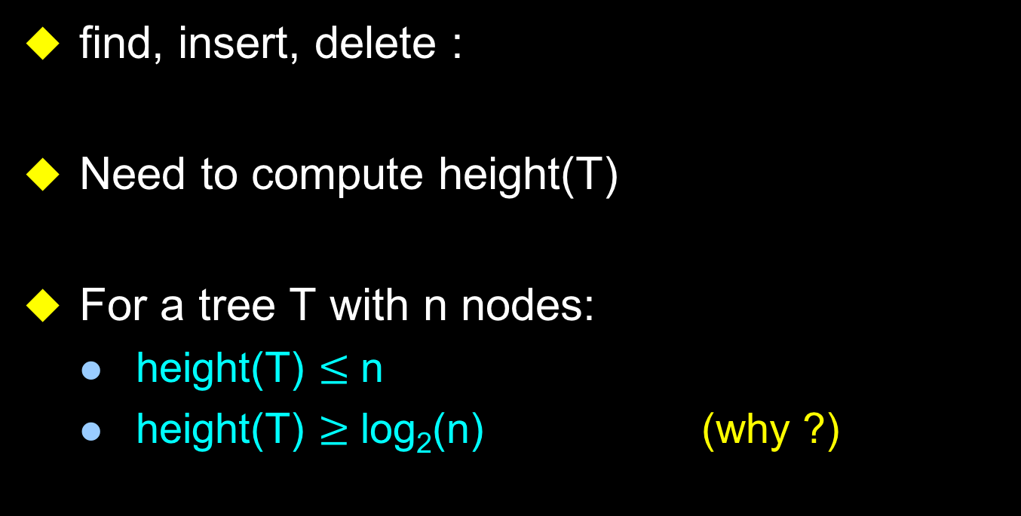
Cost of the Operations
find, insert, delete :
Need to compute height(T)
For a tree T with n nodes:
  height(T) $≤$ n
  height(T) $≥$ log₂(n) (why ?)
time = O(height(T))
Prof. Yen, “Data Structure” class

Slide 48
Height of the Binary Search Tree
Height depends critically on the order in which we insert the data:
  E.g. 1,2,3,4,5,6,7 or 7,6,5,4,3,2,1, or 4,2,6,1,3,5,7
7
4
1
6
2
5
2
6
3
4
4
3
1
3
5
7
5
2
6
1
Which insertion order corresponds to what tree ?
Which tree do we prefer and why ?
7
Prof. Yen, “Data Structure” class

Slide 49
Random Input vs. Random Trees
For three items, the shallowest tree is twice as likely as any other – effect grows as n increases. For n=4, probability of getting a shallow tree > 50%
Trees
Inputs
1,2,3
3,2,1
1,3,2
3,1,2
2,1,3
2,3,1
Prof. Yen, “Data Structure” class

Slide 50
Average cost
The average, amortized cost of n insert/find operations is O(log(n))
But the average, amortized cost of n insert/find/delete operations can be as bad as sqrt(n)
  log 10000 vs. sqrt(10000)
  Deletions make life harder
  Read the book for details
Need guaranteed cost O(log n)
Prof. Yen, “Data Structure” class

Slide 51
Time Complexity
The height of binary search tree is n in the worst case, where a binary search tree looks like a sorted sequence
To achieve good running time, we need to keep the tree balanced, i.e., with O(logn) height.

Slide 52
Self Adjusting Binary Search Trees
Insertions/removals may “deepen” and “unbalance” a binary search tree.
Self-adjusting binary search trees automatically restore balance after each insertion/removal by performing a series of rotations.
Self-adjusting binary search trees insure good worst-case performance.
Balanced Binary Search Trees
Prof. Yen, “Data Structure” class

Slide 53
AVL Tree
G. M. Adel’son-Vel’skii and E. M. Landis, “An Algorithm for the Organization of Information,” Soviet Math. Doklady 3 (1962), pp. 1259—1262.
AVL trees are balanced.
An AVL Tree is a binary search tree such that for every internal node v of T, the heights of the children of v can differ by at most 1.
An example of an AVL tree where the heights are shown next to the nodes:

Slide 54
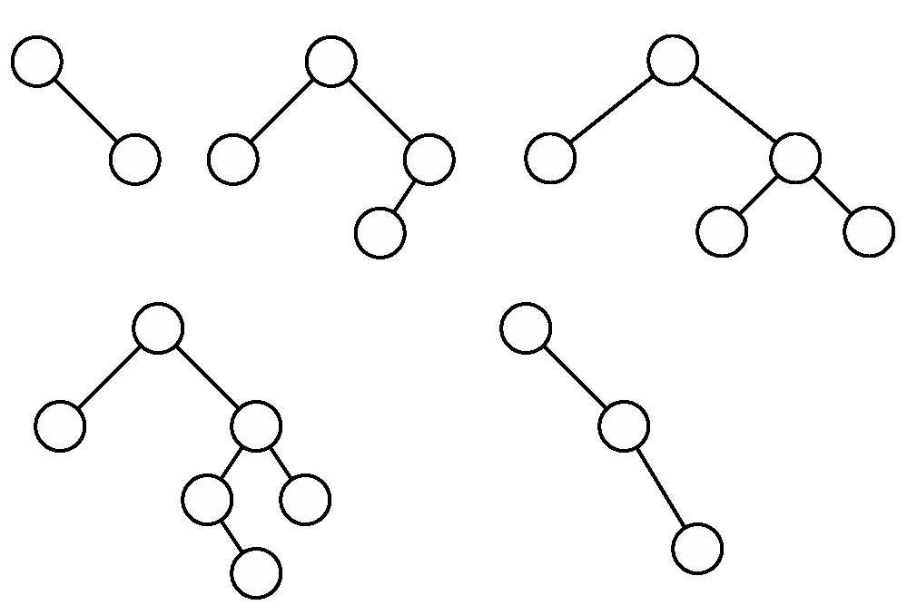
Example
❒
❒
Prof. Yen, “Data Structure” class

Slide 55
AVL Trees
h = 0
h = 1
h = 2
h = 3
Given an AVL tree of height h, what is the minimal number of nodes that the tree may contain?
Prof. Yen, “Data Structure” class

Slide 56
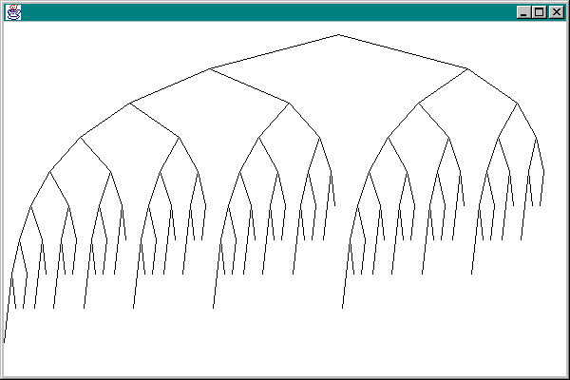
AVL - height 9
Prof. Yen, “Data Structure” class

Slide 57
Height Of An AVL Tree
The height of an AVL tree that has n nodes is at most 1.44 log₂ (n+2).
The height of every n node binary tree is at least log₂ (n+1).
log₂ (n+1) <= height <= 1.44 log₂ (n+2)
O(log(n))
Prof. Yen, “Data Structure” class

Slide 58
Insertion
A binary search tree T is called balanced if for every node v, the height of v’s children differ by at most one.
Inserting a node into an AVL tree involves performing an expandExternal(w) on T, which changes the heights of some of the nodes in T.
  If an insertion causes T to become unbalanced, we travel up the tree from the newly created node until we find the first node x such that its grandparent z is unbalanced node.
  Since z became unbalanced by an insertion in the subtree rooted at its child y, height(y) = height(sibling(y)) + 2
  Now to rebalance...
Prof. Yen, “Data Structure” class

Slide 59
The “outie” case
z - the nearest ancestor which is out of balance
n - the newly inserted node
height of T1, T2, and T3 are all the same, say h
z
y
T1
T2
T3
n
Prof. Yen, “Data Structure” class

Slide 60
single rotation
Rotate at ‘z→y’:
y is z’s right child → find y’s left child T2
Make T2 z’ new right child, and z y’s new left child.
y
z
z
y
T3
T1
T2
T3
T1
T2
n
n
Prof. Yen, “Data Structure” class

Slide 61
After the rotation
y is now the root
the height of the tree is the same as it was before inserting the node, so no other ancestor is unbalanced
the root y is balanced
y
z
T3
T1
T2
n
Prof. Yen, “Data Structure” class

Slide 62
The “innie” case
z is the nearest out-of-balance ancestor
T1 and T4 have height h
T2 and T3 have height h-1
n is the newly inserted node - either in T2 or T3
z
y
T1
x
T4
T2
T3
n
Prof. Yen, “Data Structure” class

Slide 63
Double Rotation
x
z
y
z
y
T1
x
T4
T2
T3
T1
T2
T3
T4
n
n
Prof. Yen, “Data Structure” class

Slide 64
After the Rotation
x is now the root with left child z and right child y
The height of the tree is the same as before the insertion, so no other ancestor is now out-of-balance
This tree is balanced
x
z
y
T1
T2
T3
T4
n
Prof. Yen, “Data Structure” class

Slide 65
More precisely
Rotate at ‘y→x’:
x is y’s left child → find x’s right child C
Make C y’ new left child, and y x’s new right child.
z
z
First Rotation
y
A
A
x
D
B
x
y
C
B
C
D
Prof. Yen, “Data Structure” class
Notes:
Here’s the double rotation code.
Pretty tough, eh?

Slide 66
Double Rotation Completed
First Rotation
Second Rotation
z
x
A
x
z
y
B
A
B
C
D
y
C
D
Prof. Yen, “Data Structure” class

Slide 67
The other rotations
These two demonstrations show the Single Left rotation and the Double Left rotation (used when the nearest out-of-balance ancestor is too heavy on the right)
Similar rotations are performed when the nearest out-of-balance ancestor is heavy on the left -- these are called Single Right and Double Right Rotations
Prof. Yen, “Data Structure” class

Slide 68
Deletion from an AVL Tree
Deletion of a node from an AVL tree requires the same basic ideas, including single and double rotations, that are used for insertion
We are NOT going into details here....
(Don’t need to memorize the steps; understand the principles!!)
  Please refer to any DS books or the appendix slides at the end

Slide 69
Building an AVL Tree
Input: sequence of n keys (unordered)
19 3 4 18 7
Insert each into initially empty AVL tree
But, suppose input is already sorted …
3 4 7 18 19
Can we do better than O(n log n)?
Prof. Yen, “Data Structure” class

Slide 70
AVL BuildTree
5
8
10
15
17
20
30
35
40
Divide & Conquer
  Divide the problem into parts
  Solve each part recursively
  Merge the parts into a general solution
17
How long does
divide & conquer take?
5
8
10
15
20
30
35
40
Prof. Yen, “Data Structure” class
Notes:
IT DEPENDS!

Slide 71
BuildTree Example
5
8
10
15
17
20
30
35
40
3
17
5
8
10
15
2
2
20
30
35
40
10
35
5
8
1
0
20
30
1
0
8
15
30
40
0
0
5
20
Prof. Yen, “Data Structure” class

Slide 72
Thinking About AVL
Observations
  + Worst case height of an AVL tree is about 1.44 log n
  + Insert, Find, Delete in worst case O(log n)
  + Only one (single or double) rotation needed on insertion
  + Compatible with lazy deletion
  - O(log n) rotations needed on deletion
  - Height fields must be maintained (or 2-bit balance)
Coding complexity?
Prof. Yen, “Data Structure” class

Slide 73
AVL Performance
Method | Worst Case
void insert(Comparable element) | O(Log N)
boolean contains(Comparable element) | O(Log N)
void delete(Comparable element) | O(Log N)
int size() | O(1)
boolean isEmpty() | O(1)
Prof. Yen, “Data Structure” class

Slide 74
Pros and Cons of AVL Trees
Pro:
All operations guaranteed O(log N)
The height balancing adds no more than a constant factor to the speed of insertion
Con:
Space consumed by height field in each node
Slower than ordinary BST on random data
Can we guarantee O(log N) performance with less overhead?
Prof. Yen, “Data Structure” class

Slide 75
One more note about the Tree ADT
A good DS for representing hierarchy or relationship
Important variations: binary tree, binary search tree, balanced binary search tree
Balanced Binary Search Tree
  All operations are equal or less than O(log(n))
  Good example for “Abstract” DT
ADT that is good for sorting and find
encapsulated
AVL, RB Tree, etc
User

Slide 76
Alternatives to AVL Trees
Weight balanced trees
  keep about the same number of nodes in each subtree
  not nearly as nice
Others
  Splay trees
  2-3-4 trees
  red-black trees
  B-Tree
  ➔ Will be covered in “Tree Part II” later!
Prof. Yen, “Data Structure” class

Slide 77
Appendix Slides

Slide 78
Steps in deleting X in an AVL tree
Reduce the problem to the case where X has only one child
Delete the node X. The height of the subtree formerly rooted at X has been reduced by one
We must trace the effect on the balance from X all the way back to the root until we reach a node which does not need adjustment
Prof. Yen, “Data Structure” class

Slide 79
Easy Insert
3
Insert(3)
10
1
2
5
15
0
0
0
1
2
9
12
20
0
0
17
30
Prof. Yen, “Data Structure” class
Notes:
Let’s insert 3.
This is easy!
It just goes under 2 (to the left).
Update the balances:
any imbalance?
NO!

Slide 80
Hard Insert (Bad Case #1)
3
Insert(33)
10
2
2
5
15
1
0
0
1
2
9
12
20
0
0
0
3
17
30
Prof. Yen, “Data Structure” class
Notes:
Now, let’s insert 33.
Where does it go?
Left of 30.

Slide 81
Single Rotation
3
3
10
10
2
3
2
2
5
15
5
20
1
0
0
2
1
0
1
1
2
9
12
20
2
9
15
30
0
0
1
0
0
0
0
3
17
30
3
12
17
33
0
33
Prof. Yen, “Data Structure” class
Notes:
Here’s the tree with the balances updated.
Now, node 15 is bad!
Since the problem is in the left subtree of the left child, we can fix it with a single rotation.
We pull 20 up.
Hang 15 to the left.
Pass 17 to 15.
And, we’re done!
Notice that I didn’t update 10’s height until we checked 15. Did it change after all?

Slide 82
Hard Insert (Bad Case #2)
3
Insert(18)
10
2
2
5
15
1
0
0
1
2
9
12
20
0
0
0
3
17
30
Prof. Yen, “Data Structure” class
Notes:
Now, let’s back up to before 33 and insert 18 instead.
Goes right of 17.
Again, there’s imbalance.
But, this time, it’s a zig-zag!

Slide 83
Single Rotation (oops!)
3
3
10
10
2
3
2
3
5
15
5
20
1
0
0
2
1
0
2
0
2
9
12
20
2
9
15
30
0
1
0
0
0
1
3
17
30
3
12
17
0
0
18
18
Prof. Yen, “Data Structure” class
Notes:
We can try a single rotation,
but we end up with another zig-zag!

Slide 84
Double Rotation (Step #1)
3
3
10
10
2
3
2
3
5
15
5
15
1
0
0
2
1
0
0
2
2
9
12
20
2
9
12
17
0
1
0
0
1
3
17
30
3
20
0
0
0
18
Look familiar?
18
30
Prof. Yen, “Data Structure” class
Notes:
So, we’ll double rotate.
Start by moving the offending grand-child up.
We get an even more imbalanced tree.
BUT, it’s imbalanced like a zig-zig tree now!

Slide 85
Double Rotation (Step #2)
3
3
10
10
2
3
2
2
5
15
5
17
1
0
0
2
1
0
1
1
2
9
12
17
2
9
15
20
0
1
0
0
0
0
3
20
3
12
18
30
0
0
18
30
Prof. Yen, “Data Structure” class
Notes:
So, let’s pull 17 up again.
Now, we get a balanced tree.
And, again, 10’s height didn’t need to change.

Slide 86
Deletion: Really Easy Case
3
Delete(17)
10
2
2
5
15
1
0
0
1
2
9
12
20
0
0
0
3
17
30
Prof. Yen, “Data Structure” class

Slide 87
Deletion: Pretty Easy Case
3
Delete(15)
10
2
2
5
15
1
0
0
1
2
9
12
20
0
0
0
3
17
30
Prof. Yen, “Data Structure” class
Notes:
OK, if we have a bit of extra time, do this.
Let’s try deleting.
15 is easy! It has two children, so we do BST deletion.
17 replaces 15.
15 goes away.
Did we disturb the tree?
NO!

Slide 88
Deletion: Pretty Easy Case (cont.)
3
Delete(15)
10
2
2
5
17
1
0
0
1
2
9
12
20
0
0
3
30
Prof. Yen, “Data Structure” class
Notes:
OK, if we have a bit of extra time, do this.
Let’s try deleting.
15 is easy! It has two children, so we do BST deletion.
17 replaces 15.
15 goes away.
Did we disturb the tree?
NO!

Slide 89
Deletion (Hard Case #1)
Delete(12)
3
10
2
2
5
17
1
0
0
1
2
9
12
20
0
0
3
30
Prof. Yen, “Data Structure” class
Notes:
Now, let’s delete 12.
12 goes away.
Now, there’s trouble.
We’ve put an imbalance in.
So, we check up from the point of deletion and fix the imbalance at 17.

Slide 90
Single Rotation on Deletion
3
3
10
10
2
2
2
1
5
17
5
20
1
0
1
1
0
0
0
2
9
20
2
9
17
30
0
0
0
3
30
3
Deletion can differ from insertion – How?
Prof. Yen, “Data Structure” class
Notes:
But what happened on the fix?
Something very disturbing.
What?
The subtree’s height changed!!
So, the deletion can propagate.

Slide 91
Deletion (Hard Case)
Delete(9)
4
10
2
3
5
17
1
0
2
2
12
2
9
12
20
20
0
0
1
0
1
3
30
11
15
30
15
18
0
0
0
0
0
33
13
33
13
Prof. Yen, “Data Structure” class

Slide 92
Double Rotation on Deletion
Not finished!
4
4
10
10
2
3
1
3
5
17
3
17
1
2
2
0
0
2
2
2
12
12
2
20
2
5
20
0
0
1
0
1
0
1
0
1
3
11
15
18
30
11
15
18
30
0
0
0
0
0
13
33
13
33
Prof. Yen, “Data Structure” class

Slide 93
Deletion with Propagation
4
10
What different about this case?
1
3
3
17
0
0
2
2
2
5
12
20
We get to choose whether
to single or double rotate!
0
1
0
1
11
15
18
30
0
0
13
33
Prof. Yen, “Data Structure” class

Slide 94
Propagated Single Rotation
4
4
10
17
1
3
3
2
3
17
10
20
0
0
2
2
1
2
0
1
2
5
12
20
3
12
18
30
0
1
0
1
0
0
0
1
0
11
15
18
30
2
5
11
15
33
0
0
0
13
33
13
Prof. Yen, “Data Structure” class

Slide 95
Propagated Double Rotation
4
4
10
12
1
3
2
3
3
17
10
17
0
0
2
2
1
0
1
2
2
5
12
20
3
11
15
20
0
1
0
1
0
0
0
0
1
11
15
18
30
2
5
13
18
30
0
0
0
13
33
33
Prof. Yen, “Data Structure” class

